Slide 1
SHARING THE KNOWLEDGE

Slide 2
There are over 40 000 students in Jyväskylä!
Jamk University of Applied Sciences:
Students 8500. Staff 900.
The University of Jyväskylä:
Students 14 700. Staff 2700.
The Educational Consortium Gradia:
Students 21 400
vocationas students 17 700
upper secondary high school 3700
Staff 1100

Slide 3
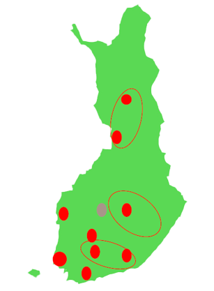
Higher education consortia and co-operation structures
XAMK of Southeastern Finland since 2017 (Mikkeli, Kouvola, Kotka, Savonlinna)
Tampere T3 project (Tampere University, TTY, TAMK + SAMK, SeAMK)
Lahti "university" project (LUT, Lahti UAS, Saimaa UAS) forms a common consortium, creating a university operating in two locations (Lahti and Lappeenranta)
Collaboration of Kuopio higher education institutions (University of Eastern Finland + Savonia UAS + Kuopio Joint Municipal Authority for Education and Training)
Shared Savilahti campus
Cooperation of Vaasa higher education institutions (University of Vaasa, VAMK, and YH Novia)
Shared campus in Palosaari
Oulu higher education institutions (University of Oulu + Oulu UAS)
Shared campus in Linnanmaa
Lapland higher education consortium (University of Lapland and Lapland UAS)
Joint campus concentration of Turku higher education institutions (University of Turku, Åbo Akademi, TUAS)
Kajaani UAS and vocational education in the same consortium
Strategic alliance of metropolitan area UASs (Haaga-Helia, Laurea, Metropolia)
EduFutura co-operation in Jyväskylä
Higher education JYU & JAMK and as an equal partner, Gradia, which is the largest secondary education provider in Finland

Slide 4
EduFutura Jyväskylä is a learning, development and research competence cluster.

Slide 5
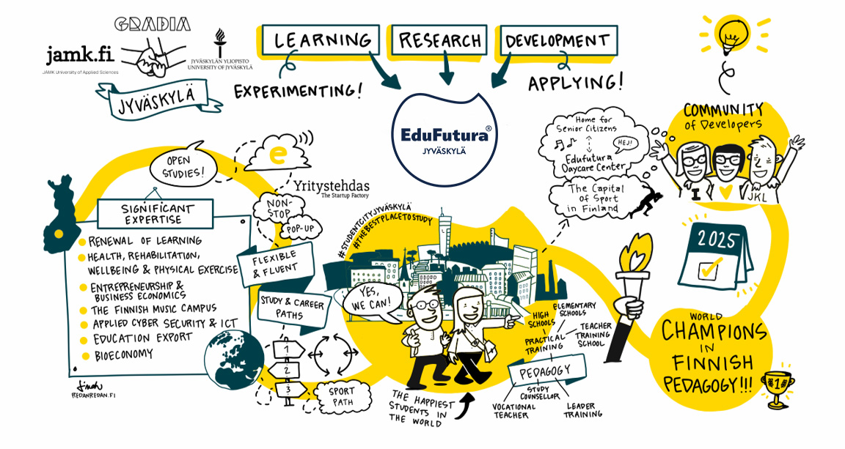

Slide 6
For students we collaboratively develop the learning solutions of the future and create diverse opportunities to pursue flexible study paths.
For staff we develop the cooperation and networking between the employees of our educational organisations. When we know each other, we can create new ideas and solutions.
For companies and working life we predict the competence needs of the future and create entrepreneurship opportunities for the students.

Slide 7
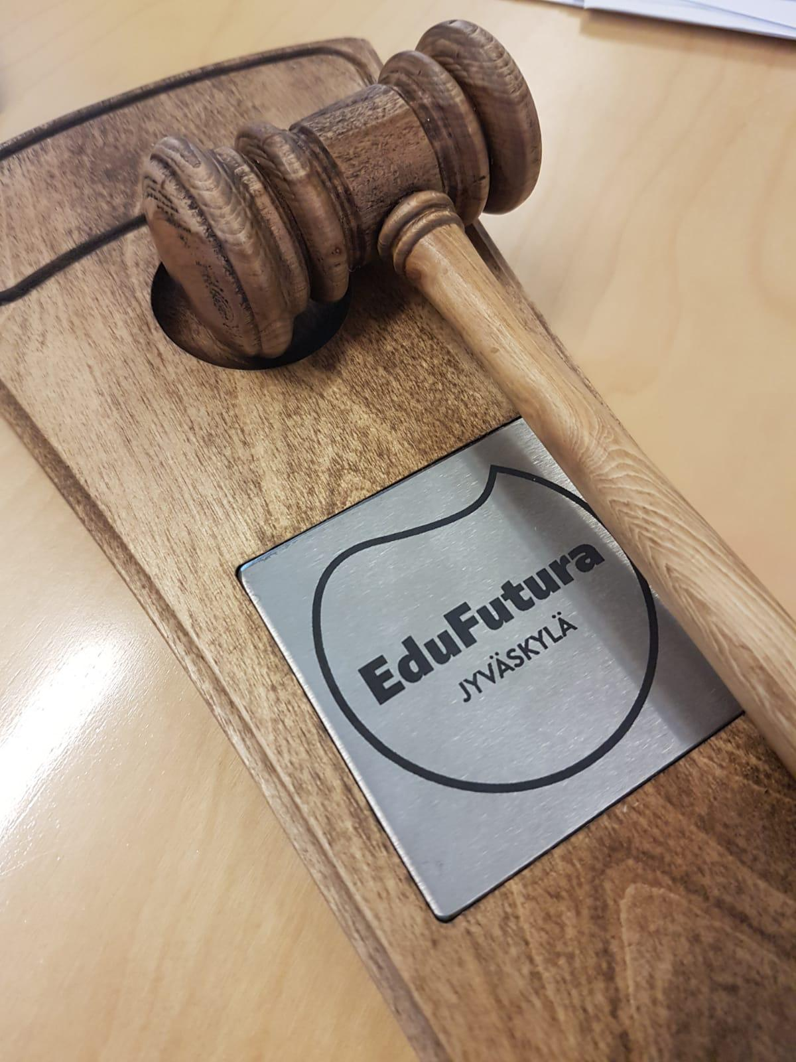
EduFutura co-operation since 2016
The rectors and leaders signed the EduFutura co-operation agreement in the spring 2016.
The aim of the agreement is to deepen the co-operation so that the students can take courses and modules from the other EduFutura institutions and build up their individual learning path.

Slide 8
The EduFutura Jyväskylä co-operation focuses on
Renewal of learning
Health, rehabilitation, well-being and physical activity
Entrepreneurship and the promotion of business skills
The Finnish Music Campus
ICT and applied cyber security
Resource-wise and responsible bio-economy
Education export (EduCluster)

Slide 9
Cross-instutional studies in EduFutura
Higher education studies while attending an upper secondary school or vocational studies
Cross-instutional studies between higher education (Jamk University of Applied Sciences and University of Jyväskylä
Vocational studies for higher educations students

Slide 10
There are over 200 courses available at the EduFutura online course catalogue
Students can take courses and modules that fit their personal study plan from the other EduFutura institutions.
The studies will be recognised as a part of degree in students home institution.
Taking courses from the other EduFutura institutions is free of charge.

Slide 11
Student promise
Individual and flexible study paths
Social promise
Competitiveness and vitality through future-oriented competence and work life services
Promise of sustainable resources
High-quality, cost-efficient shared structures

Slide 12
Thank you!
SHARING
THE KNOWLEDGE
www.edufutura.fi/en

